Slide 1
MOD 3
Final Project

Slide 2
Task
The focus will be on predicting the performance of pitchers on a Major League Baseball team, in order to aid the front office in making decisions on what class of pitch to acquire for the following season.

Slide 3
OSEMN Process
Obtain the Data
Scrub the Data
Explore the Data
Model the Data
Interpret the model

Slide 4
Obtain the Data
Downloaded dataset found at http://www.seanlahman.com/baseball-archive/statistics
Subset data to include observations from 2008 - 2019.

Slide 5
2. Scrub the Data
Checked for missing values and dropped ones that were found.
Created new features in order to help label the data points.
After labeling data points unnecessary features were dropped along with the feature created to label data.

Slide 6
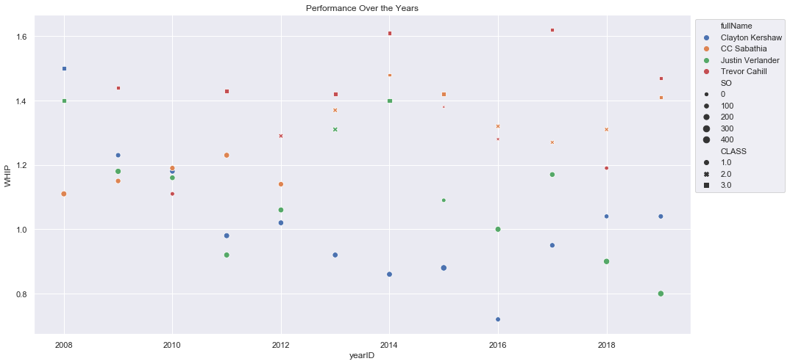
3. Explore the Data

Slide 7
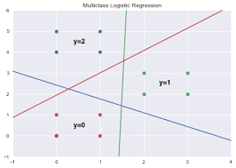
4. Model the Data
Logistic Regression
Notes:
Dairy products seem to be a significant part of every order. Not as significant as Meat/Poultry, but that is probably due to higher unit prices.
Employees should consider selling Dairy products with every order and aggressively offer the specific products that generate the most revenue.

Slide 8
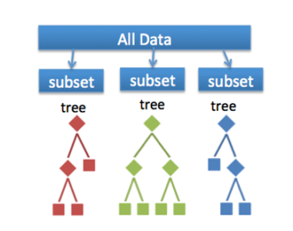
Random Forests

Slide 9
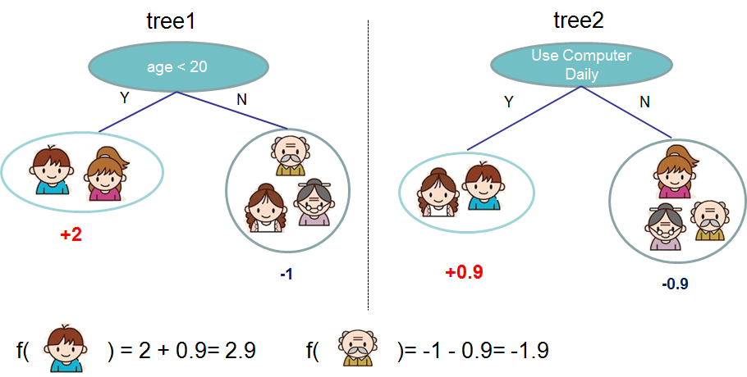
XGBoost

Slide 10
5. Interpret
These are the metrics from the best performing model:
Logistic Regression:
Accuracy: 89%
Precision class 1: 93%
Precision class 2: 82%
Precision class 3: 88%

Slide 11
Future Work
I will into possibly dropping the features with “high importance” to see its effect on the models.
Further investigation into how salaries can help a team decide who to take on.
More research into the different stats used for players and how it might affect their value.

Slide 12
THANK YOU!
Jose J. Villalobos - Student Flatiron School/Data Science
E-mail: teacherjoe83@hotmail.com
GitHub: https://github.com/UberJoe83

